Slide 1
CSE 1062 Fundamentals of Programming Lecture #11
Spring 2016
Computer Science & Engineering Program
The School of EE & Computing
Adama Science & Technology University

Slide 2
Outline
Files and Streams
I/O file stream objects and functions
Reading and writing character-based files
Random file access
File streams as function arguments
Case Study: Weather Forecast File Updates
Reading Assignments
Chapter 8 of the text book
About ASCII Codes
http://www.theasciicode.com.ar

Slide 3
I/O File Stream Objects and Functions
To store and retrieve data outside a C++ program, two items are needed:
A file
A file stream object
A file is a collection of data stored together under a common name, usually on disk, magnetic tape, USB drive, or CD
Each file has a unique file name, referred to as file’s external name

Slide 4
I/O File Stream Objects and Functions
Choose filenames that indicate the type of data in the file
Two basic types of files exist
Text files
(also known as character-based files)
Binary files

Slide 5
File Stream Objects
File stream: A one-way transmission path used to connect a file stored on a physical device, such as a disk or CD, to a program
Each file stream has its own mode that determines direction of data on transmission path
That is, whether path moves data from a file to a program or from a program to a file
Input file stream: File stream that receives or reads data from a file to a program
Output file stream: File stream that sends or writes data to a file

Slide 6
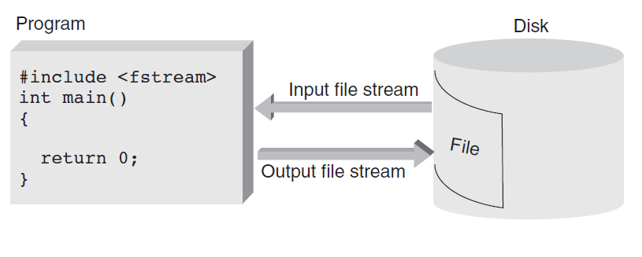
File Stream Objects
For each file your program uses, regardless of file’s type, a distinct file stream object must be created

Slide 7
File Stream Functions
Each file stream object has access to functions defined for its class
Methods perform following functions:
Connecting stream object name to external filename: opening a file
Determining whether successful connection has been made
Closing connection: closing a file
Getting next data item into program from input stream
Putting new data item from program onto output stream

Slide 8
File Stream Functions
When existing file is connected to input stream, file’s data is made available for input, starting with first data item in file
Called read mode or input mode
File connected to output stream creates new file and makes file available for output
Called output mode
When opening file for input or output, check that connection has been established before attempting to use file

Slide 9
File Stream Functions

Slide 10
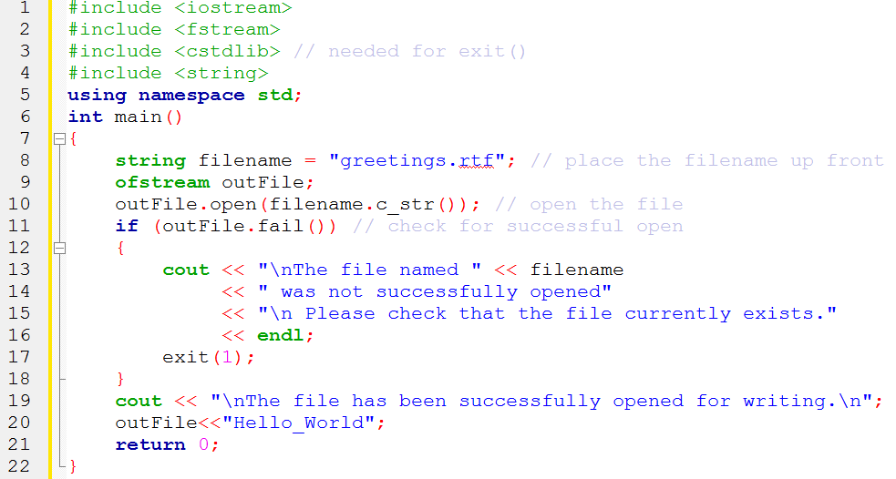
Example 1

Slide 11
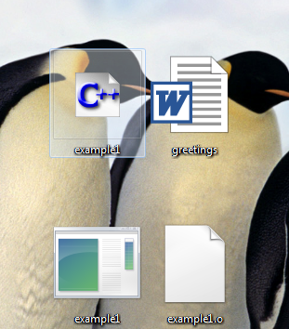
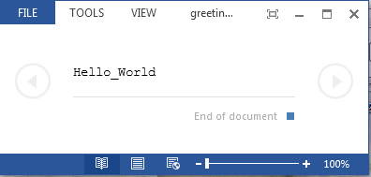
Desktop
File Opened

Slide 12
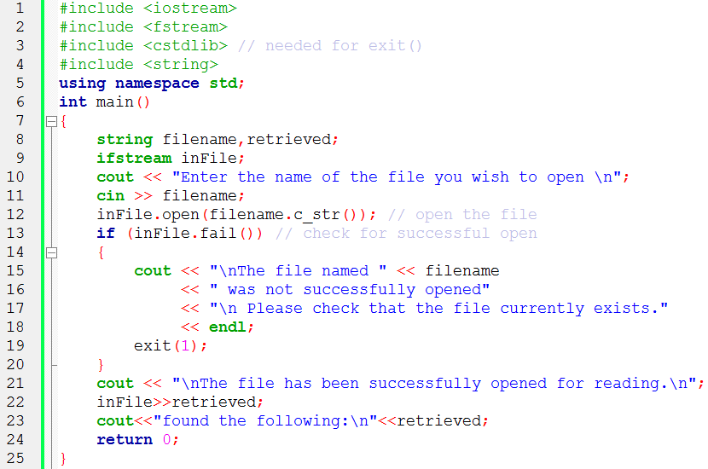
Example 2

Slide 13
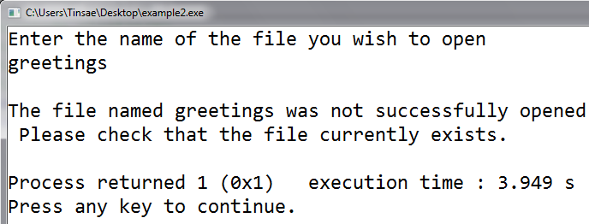
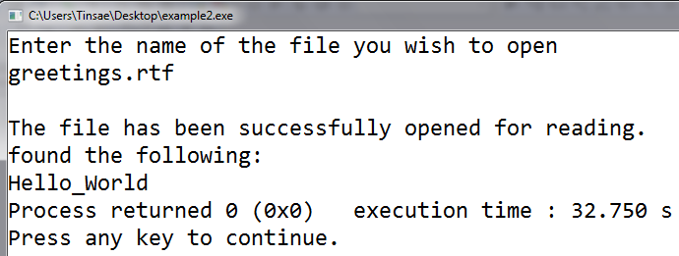
Example 2: Testing

Slide 14
Closing a File
File is closed using close() method
This method breaks connection between file’s external name and file stream, which can be used for another file
Because all computers have limit on maximum number of files that can be open at one time, closing files no longer needed makes good sense
Any open files existing at end of normal program execution are closed automatically by OS

Slide 15
Reading and Writing Character-Based Files
Reading or writing character-based files involves almost identical operations for reading input from keyboard and writing data to screen
For writing to a file, cout object is replaced by ofstream object name declared in program
Reading data from text file is almost identical to reading data from standard keyboard, except cin object is replaced by ifstream object declared in program

Slide 16
Example 3

Slide 17
Reading from a Text File

Slide 18
Example 4

Slide 19
Standard Device Files
Logical file object: Stream that connects a file of logically related data to a program
Physical file object: Stream that connects to hardware device such as keyboard, screen, or printer
Actual physical device assigned to your program for data entry is formally called standard input file
cin method calls are routed to this standard input file
cout method calls are written to a device that has been assigned as standard output file

Slide 20
Random File Access
File access: Refers to process of retrieving data from a file
Two types of file access
Sequential file access
Random file access
File organization: Refers to the way data is stored in a file
The files you have used and will continue to use have a sequential organization, meaning characters in file are stored in a sequential manner

Slide 21
Random File Access
Each open file has been read in a sequential manner, meaning characters are accessed one after another, which is called sequential access
Although characters are stored sequentially, they don’t have to be accessed in same way

Slide 22
Random File Access
In random access, any character in opened file can be read without having to read all characters stored ahead of it first
To provide random access, each ifstream object creates a file position marker automatically
This marker is a long integer representing an offset from the beginning of file

Slide 23
Random File Access
File Position Marker Functions
seek() method allows programmer to move to any position in file
Character’s position is referred to as its offset from the start of file

Slide 24
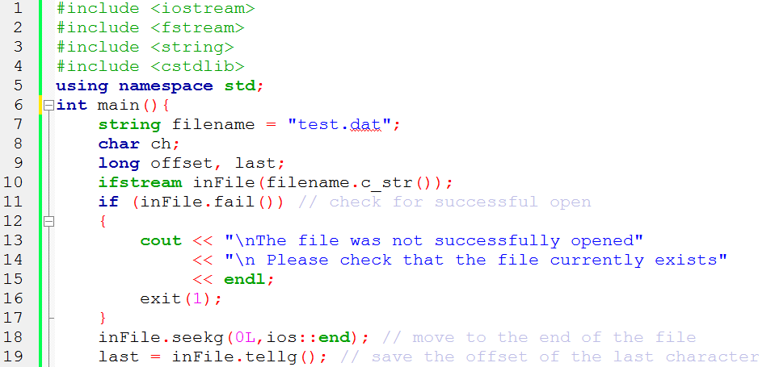
Example 5: Using seekg() and tellg()
Suppose test.dat contains this text

Slide 25
Example 5: Using seekg() and tellg()
-18 | -17 | -16 | -15 | -14 | -13 | -12 | -11 | -10 | -9 | -8 | -7 | -6 | -5 | -4 | -3 | -2 | -1
0 | 1 | 2 | 3 | 4 | 5 | 6 | 7 | 8 | 9 | 10 | 11 | 12 | 13 | 14 | 15 | 16 | 17 | 18
T | h | e |  | g | r | a | d | e |  | w | a | s |  | 9 | 2 | . | 5 | EOF

Slide 26
File Streams as Function Arguments
A file stream object can be used as a function argument
The function’s formal parameter must be a reference to the appropriate stream, either ifstream& or ofstream&
Examples: inOut(), getOpen()

Slide 27
Example 7: File Streams as Function Arguments

Slide 28
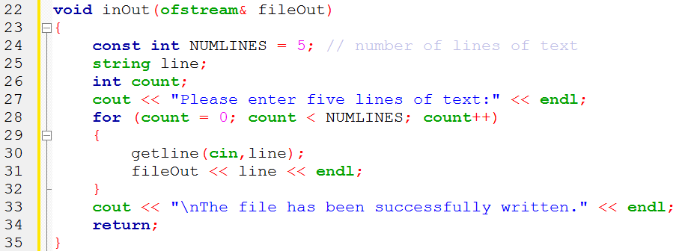
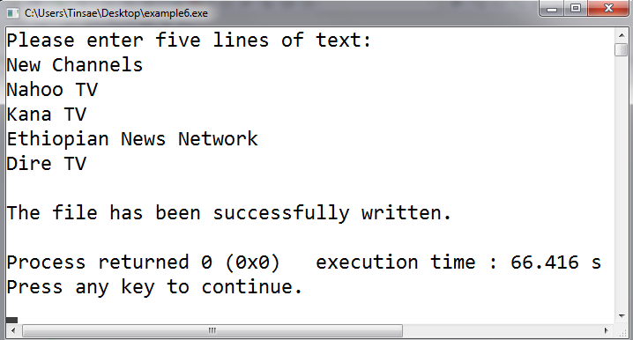
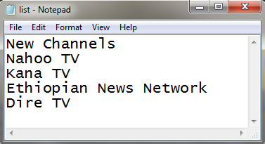
Example 7: File Streams as Function Arguments

Slide 29
Case Study: Weather Forecast File Updates
After a data file has been created, application programs are typically written to read and update the file with current data
In this case study, a file is used as a database storing the ten most recent temperature forecasts of Addis Ababa
Analyze the problem
Develop a solution
Code the solution
Test and correct the program

Slide 30
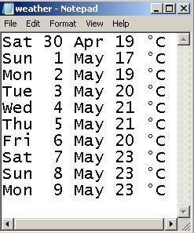
Case Study: Weather Forecast File Updates
Analyze the Problem
Data Obtained from http://www.timeanddate.com/weather/ethiopia/addis-ababa/ext
A file containing the ten most recent forecasts is created
File Name and Extension: weather.in
Day | Temperature
Sat, 30 Apr | 12 / 19 °C
Sun, 1 May | 13 / 17 °C
Mon, 2 May | 12 / 19 °C
Tue, 3 May | 11 / 20 °C
Wed, 4 May | 10 / 21 °C
Thu, 5 May | 11 / 21 °C
Fri, 6 May | 10 / 20 °C
Sat, 7 May | 12 / 23 °C
Sun, 8 May | 12 / 23 °C
Mon, 9 May | 11 / 23 °C
Tue, 10 May | 11 / 22 °C
Wed, 11 May | 11 / 23 °C
Thu, 12 May | 11 / 21 °C
Fri, 13 May | 10 / 21 °C
Sat, 14 May | 11 / 22 °C
Only Higher Temperatures
Oldest
Recent

Slide 31
Case Study: Weather Forecast File Updates
Analyze the Problem
The input data for this problem consists of
a file of 10 daily weather forecasts
Each forecast contains
a day (Mon-Sun), date (1-31), month(Jan-Dec), temperature(0-35)
a user-input value of the most recent weather forecast. It contains
a day (Mon-Sun), date (1-31), month(Jan-Dec), temperature(0-35)
There are two required outputs:
A file of the 10 most recent daily forecasts values
The average of the data in the updated file

Slide 32
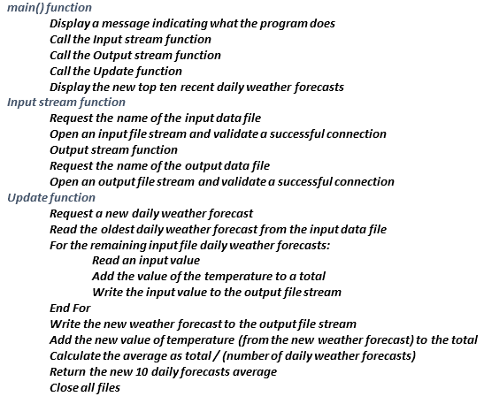
Case Study: Weather Forecast File Updates
Develop a Solution

Slide 33
Case Study: Weather Forecast File Updates

Slide 34
Case Study: Weather Forecast File Updates

Slide 35
Case Study: Weather Forecast File Updates

Slide 36
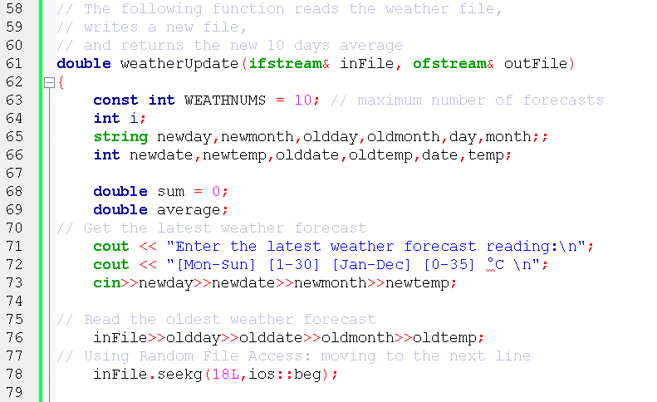
Case Study: Weather Forecast File Updates

Slide 37
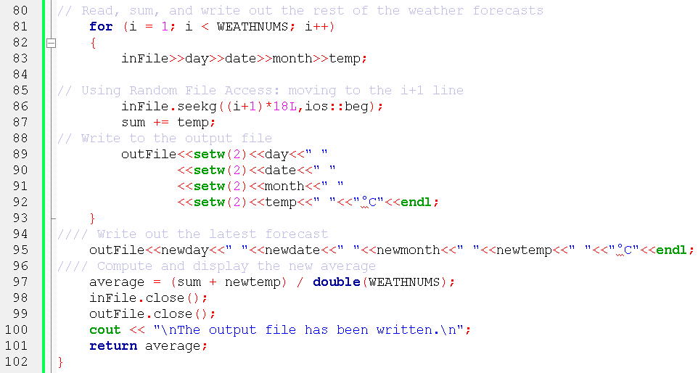
Case Study: Weather Forecast File Updates

Slide 38
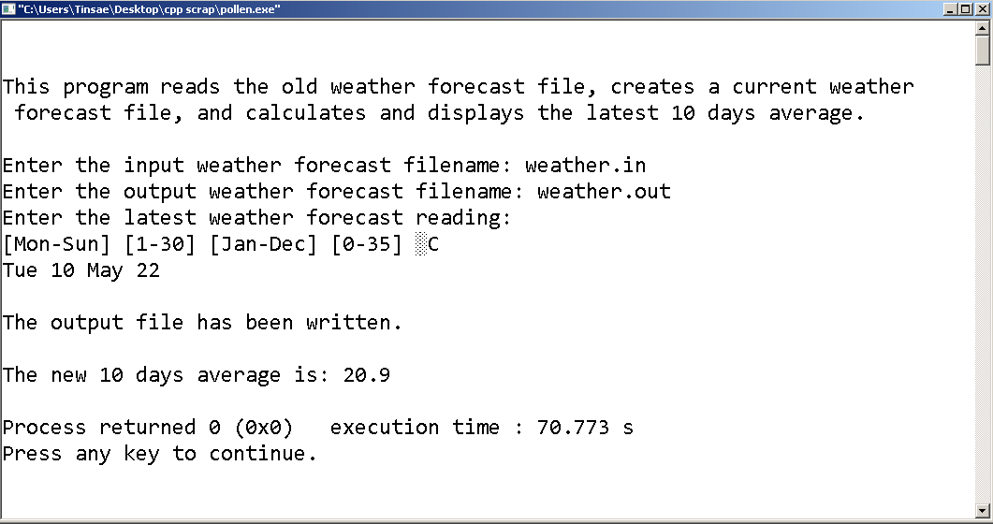
Testing the Program

Slide 39
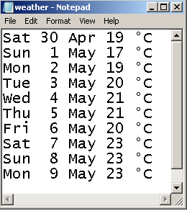
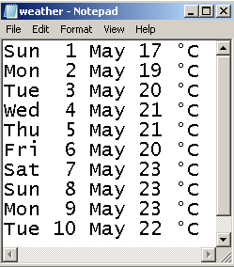
Testing the Program
weather.in | weather.out
0 | 1 | 2 | 3 | 4 | 5 | 6 | 7 | 8 | 9 | 10 | 11 | 12 | 13 | 14 | 15 | 16 | 17
S | a | t |  | 3 | 0 |  | A | p | r |  | 1 | 9 |  | ° | C | LF | LF
18 | 19 | 20 | 21 | 22 | 23 | 24 | 25 | 26 | 27 | 28 | 29 | 30 | 31 | 32 | 33 | 34 | 35
S | u | n |  |  | 1 |  | M | a | y |  | 1 | 7 |  | ° | C | LF | LF

Slide 40
Looking ASCII Codes Using get Function

